Slide 1
A Network Sniffing Tool :
Text Bandit
Supervised By : Mohammed Shafiul Alam Khan
Submited By : Pritom Kumar Das
Roll : 0919
Date: 07 March , 2018

Slide 2
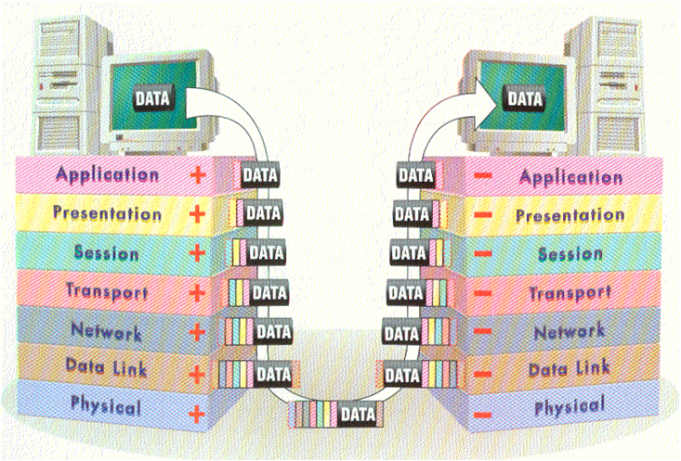
Background
figure 1 : Data Transport in network.

Slide 3
Why Extracting Text From Packet

Slide 4
Work till Mid Term
My work on this project is saved in my Github Account.
Here is my SPL Project link on github .
https://github.com/PritomKumar/SPLproject-1

Slide 5
What to do in Future

Slide 6
Advantage of Text Sniffing

Slide 7
Thank You

